Slide 1
3.1 Weekly Journal
MS 501 Game Production and Documentation
Selik Samai
09/24/2023

Slide 2
Chapter 8 User Stories
Definition: A user story is a short description of a game, tool, or pipeline feature that has a clear value to a user.
I quickly realized that STEM for kiddos was way ahead in this regard. When I joined the team, we already had Trello with much of the tasks already created. At the same time, we didn’t necessarily have all tasks assigned to everyone. I identified this in week 2 and worked with our lead to assign some very important stories to myself.
STEM for Kiddos

Slide 3
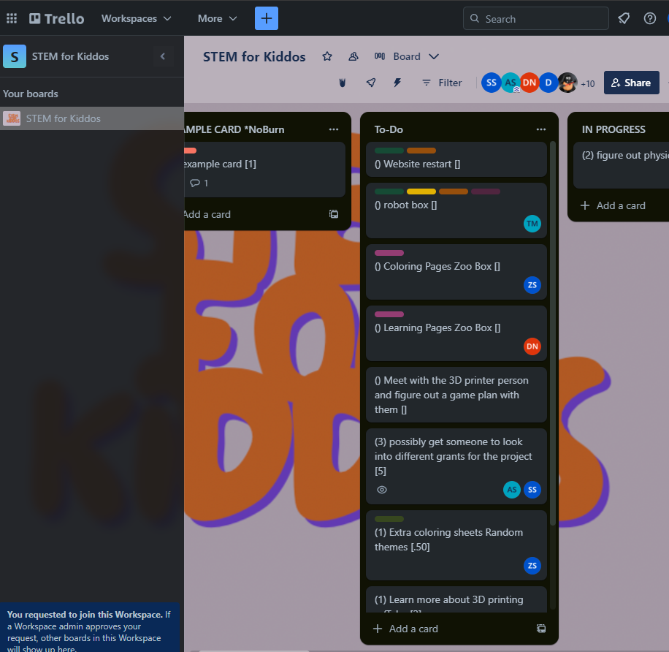
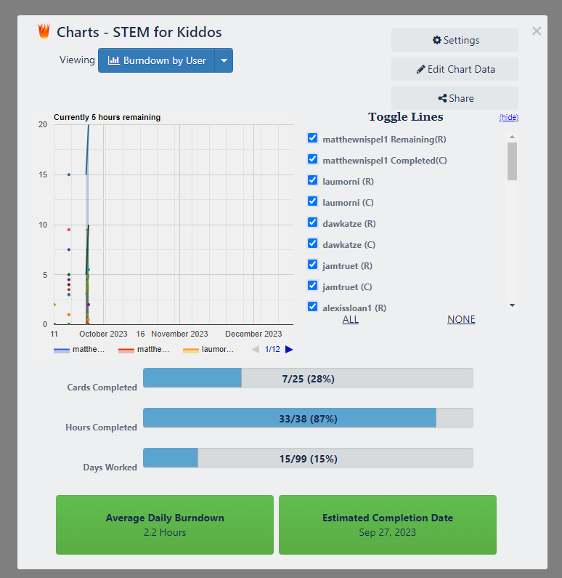
Trello & My burn down chart

Slide 4
Chapter 9 Agile Release Planning
Definition: Scrum describes releases as major goals that occur every several months, comparable to milestones or E3 or marketing demos in the level they are polished…A release plan has more flexibility as features emerge from the sprints.
I personally didn’t have much experience with the release planning stage for the STEM for kiddos project, but this is something the team is actively engaging with. We currently do have a burn down chart and I believe the website we have and are currently redesigning is the most applicable to this level of effort.

Slide 5
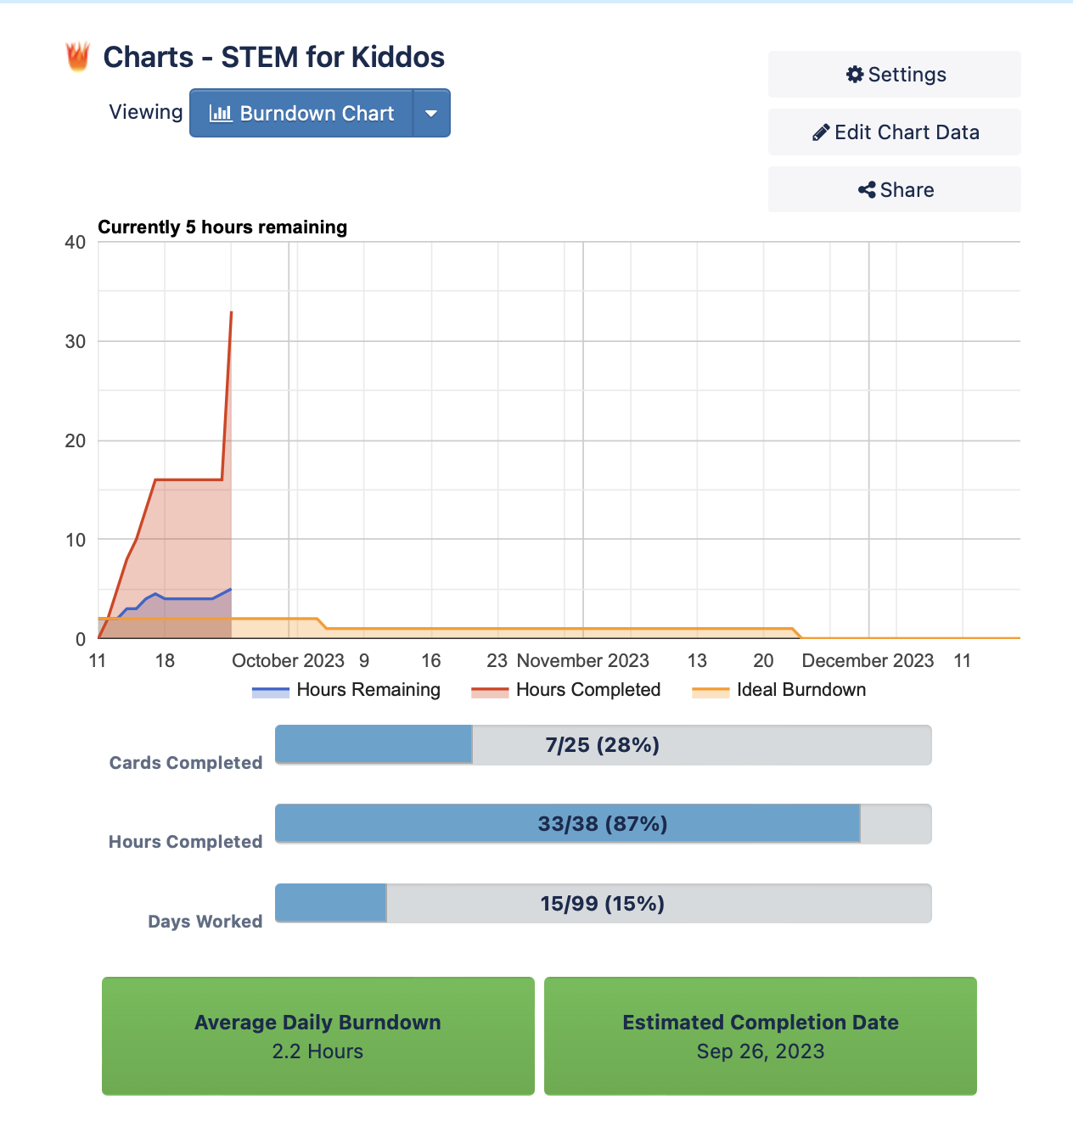
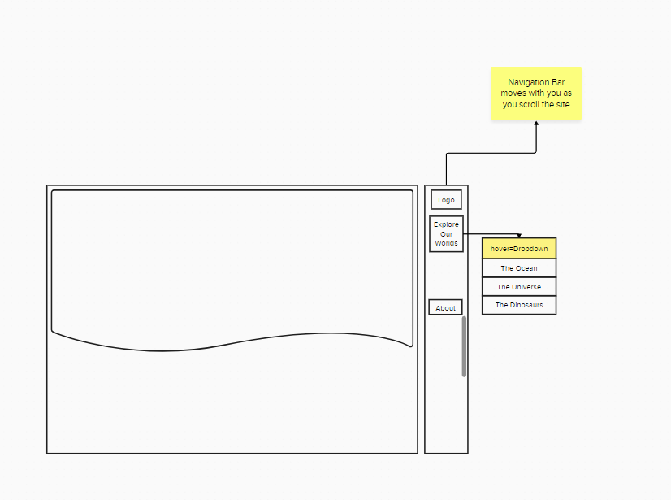
Redesign effort: Github & Wireframe
Burndown Chart

Slide 6
Chapter 10 Video Game Project Management
Definition: The project management Institute’s PMBOK defines a project as “a temporary endeavor undertaken to create a unique product or service.”
In this area, Alexis takes this role primarily. In my conversations with her, I made it a point to help identify any areas where we need contributions. Ideally, the STEM for kiddos is something that continue outside of this current semester and so we identified that advertising as well as grants for funding the boxes is something that I should focus on. This also for individuals to focus on certain areas and not have too many cooks in a particular kitchen. My main contribution will eventually lead to us producing sample kits that we can possibly show advertisers and businesses in the future for possibly receiving additional grants. This mostly targets the managing cost, schedule and scope solution that is part of project management.

Slide 7
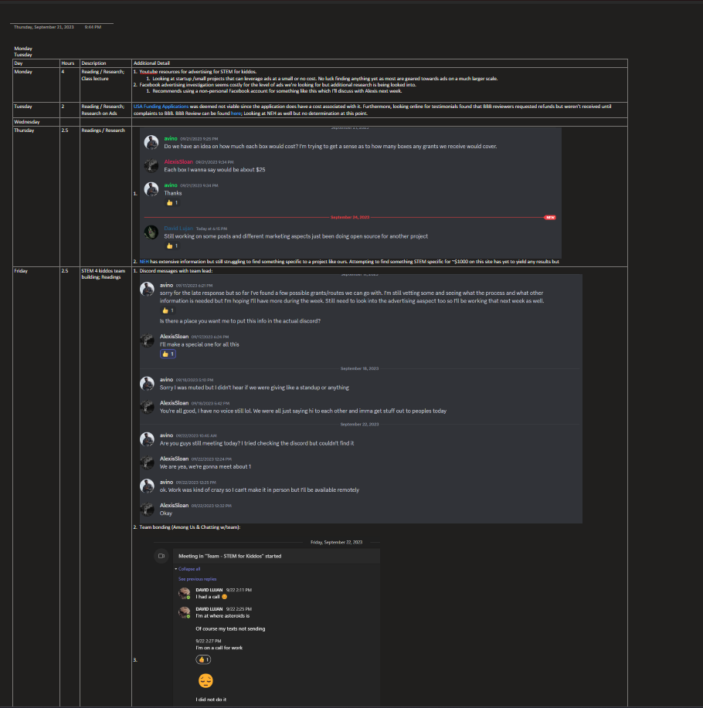
I used OneNote as a draft for my weekly sprint logs. I found this to be the easiest way for me at this time to record what I’ve done and what still needs to get done. I think for week 4 I’ll try and pivot to using the blog approach via my github site. I’ll add to my onenote blog as a draft and then incorporate those changes into the github. This approach allows me to stick to a better schedule if I contribute daily and also allows for the Kanban practice to be more identifiable
GITHUB

Slide 8
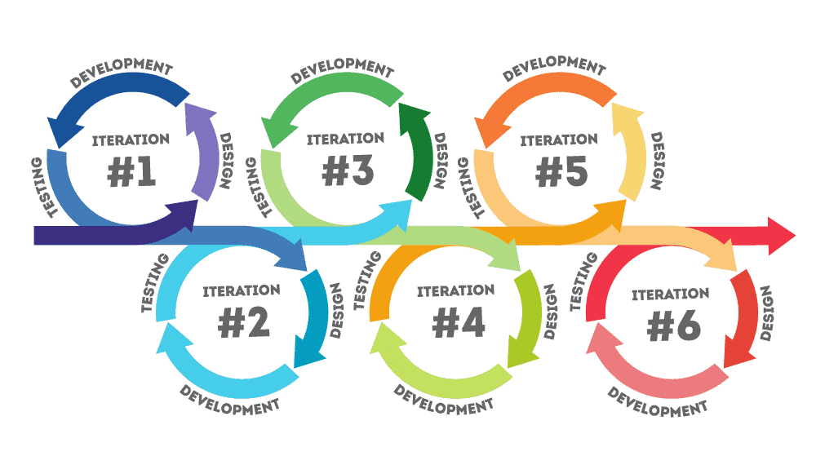
Chapter 11 Faster Iterations
Definition: Iteration refers to the practice of creating an initial version of something (artwork, code, or a design), examining it, and then revising it until it’s sufficiently improved.

Slide 9

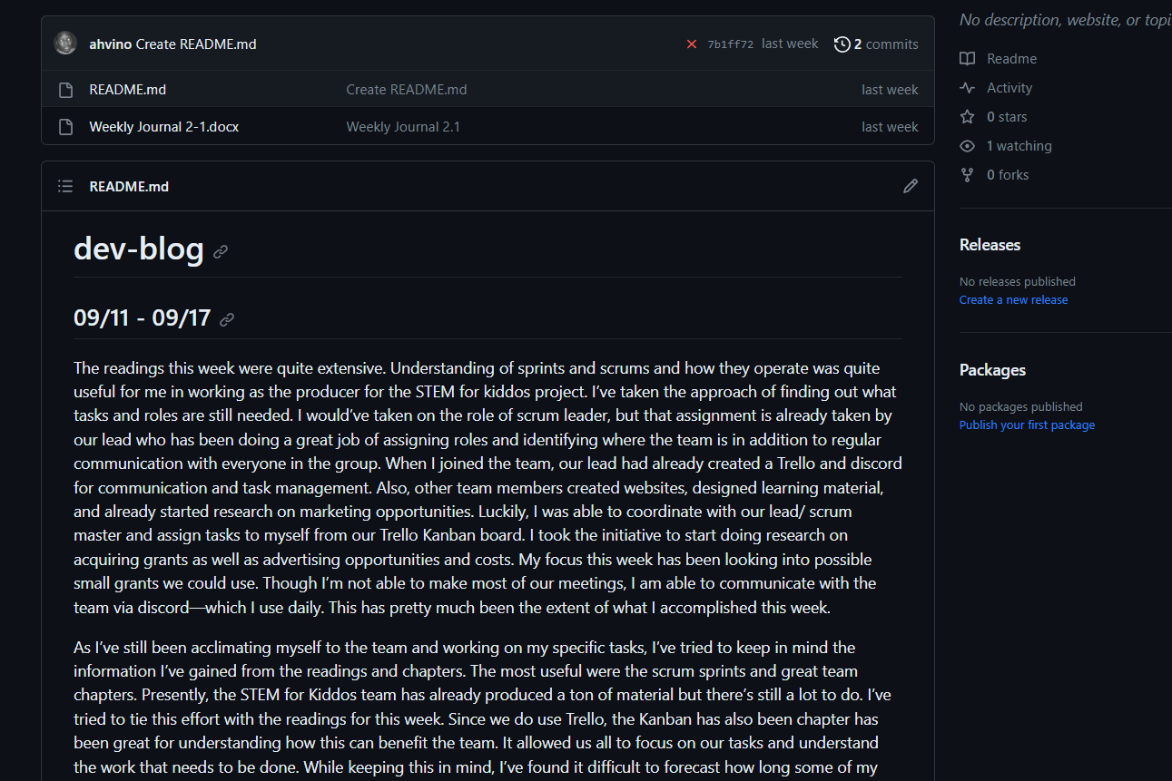
I spoke to this earlier, but I’ll be using my Github as my way to iterate faster. By making modifications at least every other day, I’m able to stay on task a lot easier.

Slide 10
Conclusion Dev-Blog
I think overall, I need to refine my process based off the chapters I read. These chapters identified some mistakes I made that force a lot of work on the tail end which is not ideal in any environment. In particular, chapter 11 “Faster Iterations” is what will most likely fuel my success going forward. It will help me refine my process and not lose sight of certain tasks. I just need to keep in mind that none of this needs to be perfect but making a little bit of progress daily will lead to a better outcome than spending most of the time at the tail end of a given sprint.

